Slide 1

Badges trend
TEAM 01
Tang Longfei, qin yu, ge song, zhan mingwei

Slide 2






motivation
Have you played with your university badges?

Slide 3


motivation
Have you played with your university badges?
For me…..
Of course !!!

Slide 4




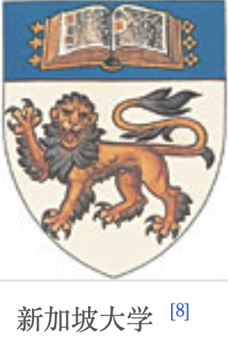
motivation
White mountain and black water
Designed by Lin Huiyin
Actually, there are indeed some similar patterns and icons among badges existing.
Universities in Singapore
So, what is the pattern within and across countries?
That’s our question.
Merged in 1980s

Slide 5
agenda
Dataset
Major workflow
Result analysis
Visualization: our DEMO
Summary & Future work
Q&A

Slide 6
Date SET
Using SIMULATION BROWSING

Slide 7
WHAT DATA ?
Logos of all the univesities from 14 countries (or cities)
Australia
Canada
China
France
…..
Logos of top 160 university on CSRanking website in USA
Univerisity of 211 + 985 program in CHINA

Slide 8
How to get data ?
Get the university list from wikipedia or somewhere else
Send http request with python <requests> package
Parse the html with <BeautifulSoup> or <pandas>
Da Da ! List Got
Crawl the images with Google Image Search Engine
Simulation browsing with python code(demo)
Enter keyword, download the first image in the result and label them with the keyword

Slide 9
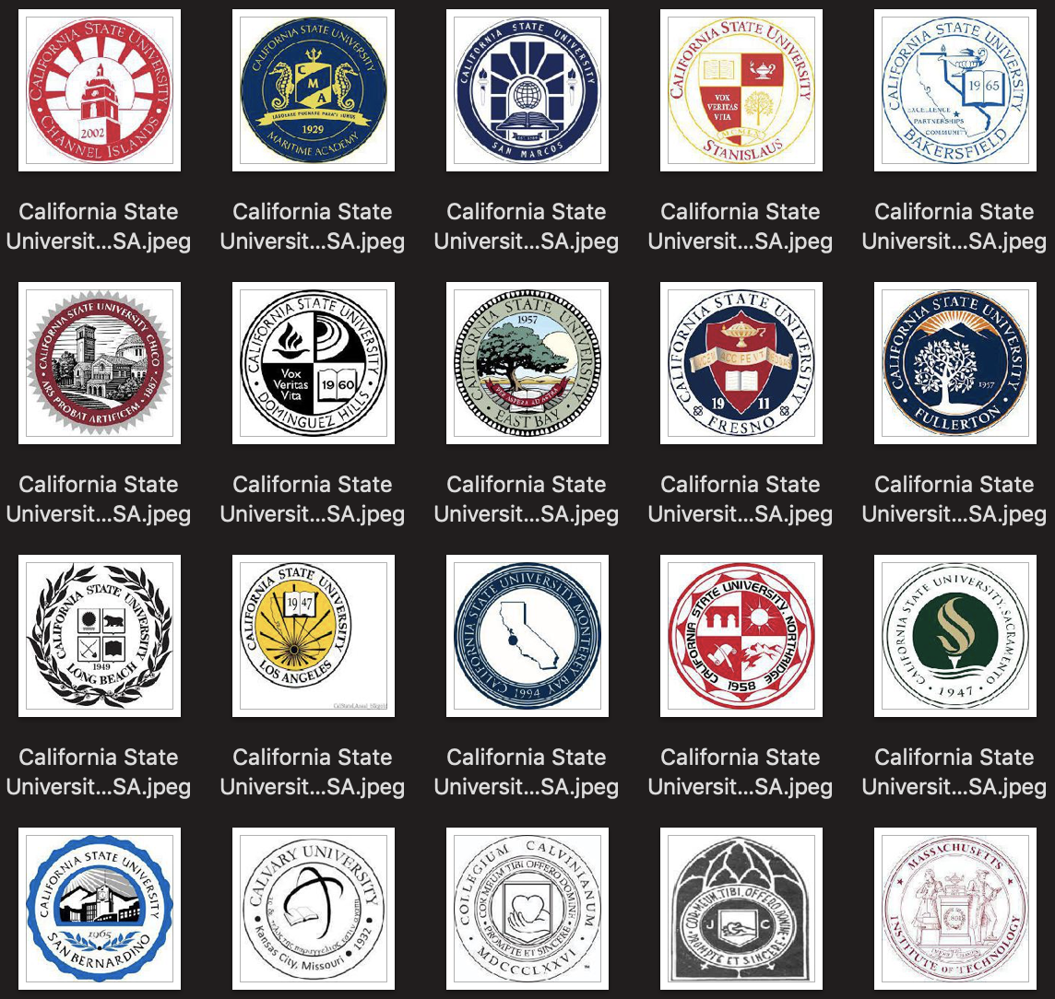
How to get data ?
Logos of universities from USA
In the end, we get 6389 images in total

Slide 10
Data Clean
Remove some weird images manually
Automatically cut the pure color edge
Convert all the image into .jpeg format => RGB
Resize image to certain size
After all the steps above, our dataset now contains 4k university logos

Slide 11
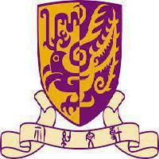















Slide 12
Major workflow and analysis
Edge detection
Convolutional Autoencoder
PCA for dimension reduction
K-means for clustering
Community Detection within cluster

Slide 13

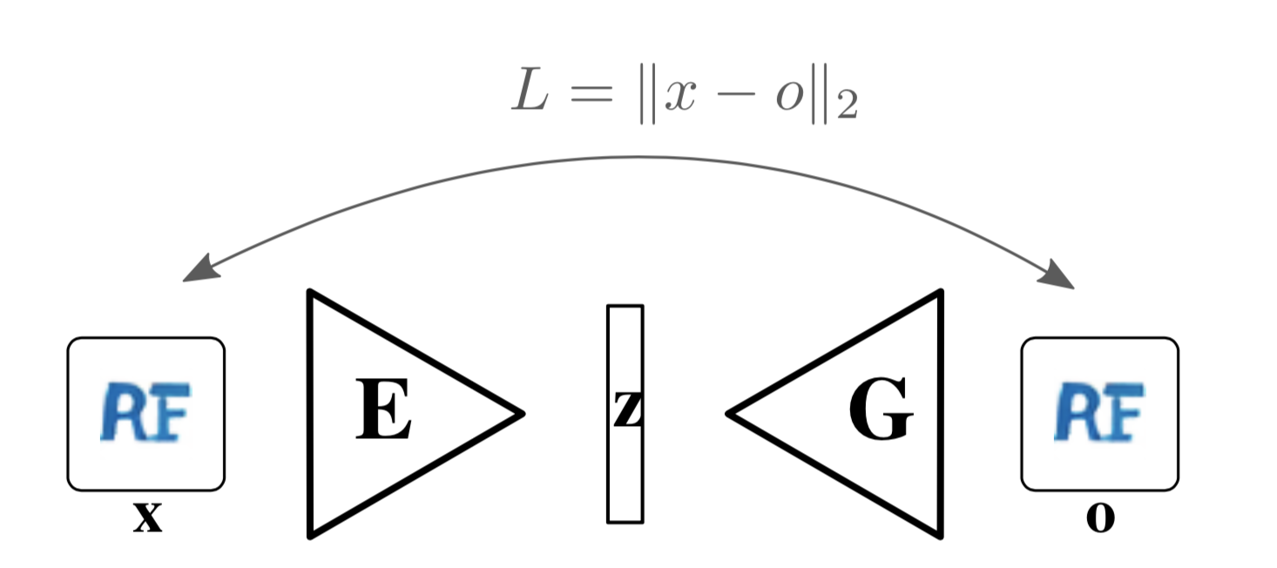

Workflow
Our main focus is the shape rather than color, so we firstly applied edge detection algorithm on all the training image.
Convolutional Autoencoder is applied to extract the features of image. it is trained using a simple L2 loss between original and reconstructed image.
All images are then encoded to latent vectors.
Followed by a PCA dimensionality reduction and then do K-means clustering on the reduced space.
Within each cluster, we applied community detection method.
Data set
Edge detection
PCA
K-means
Community Detection within each cluster

Slide 14
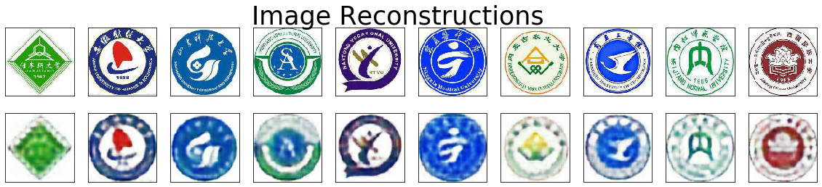
Convolutional autoencoder Result
After 5000 training epochs
Then， we got …
Valid reconstructed images ?

Slide 15

A peek
Wait…
Before we doing community detection.
We can reduce the dimension to 2, and then we can see the distribution of all the images!

Slide 16
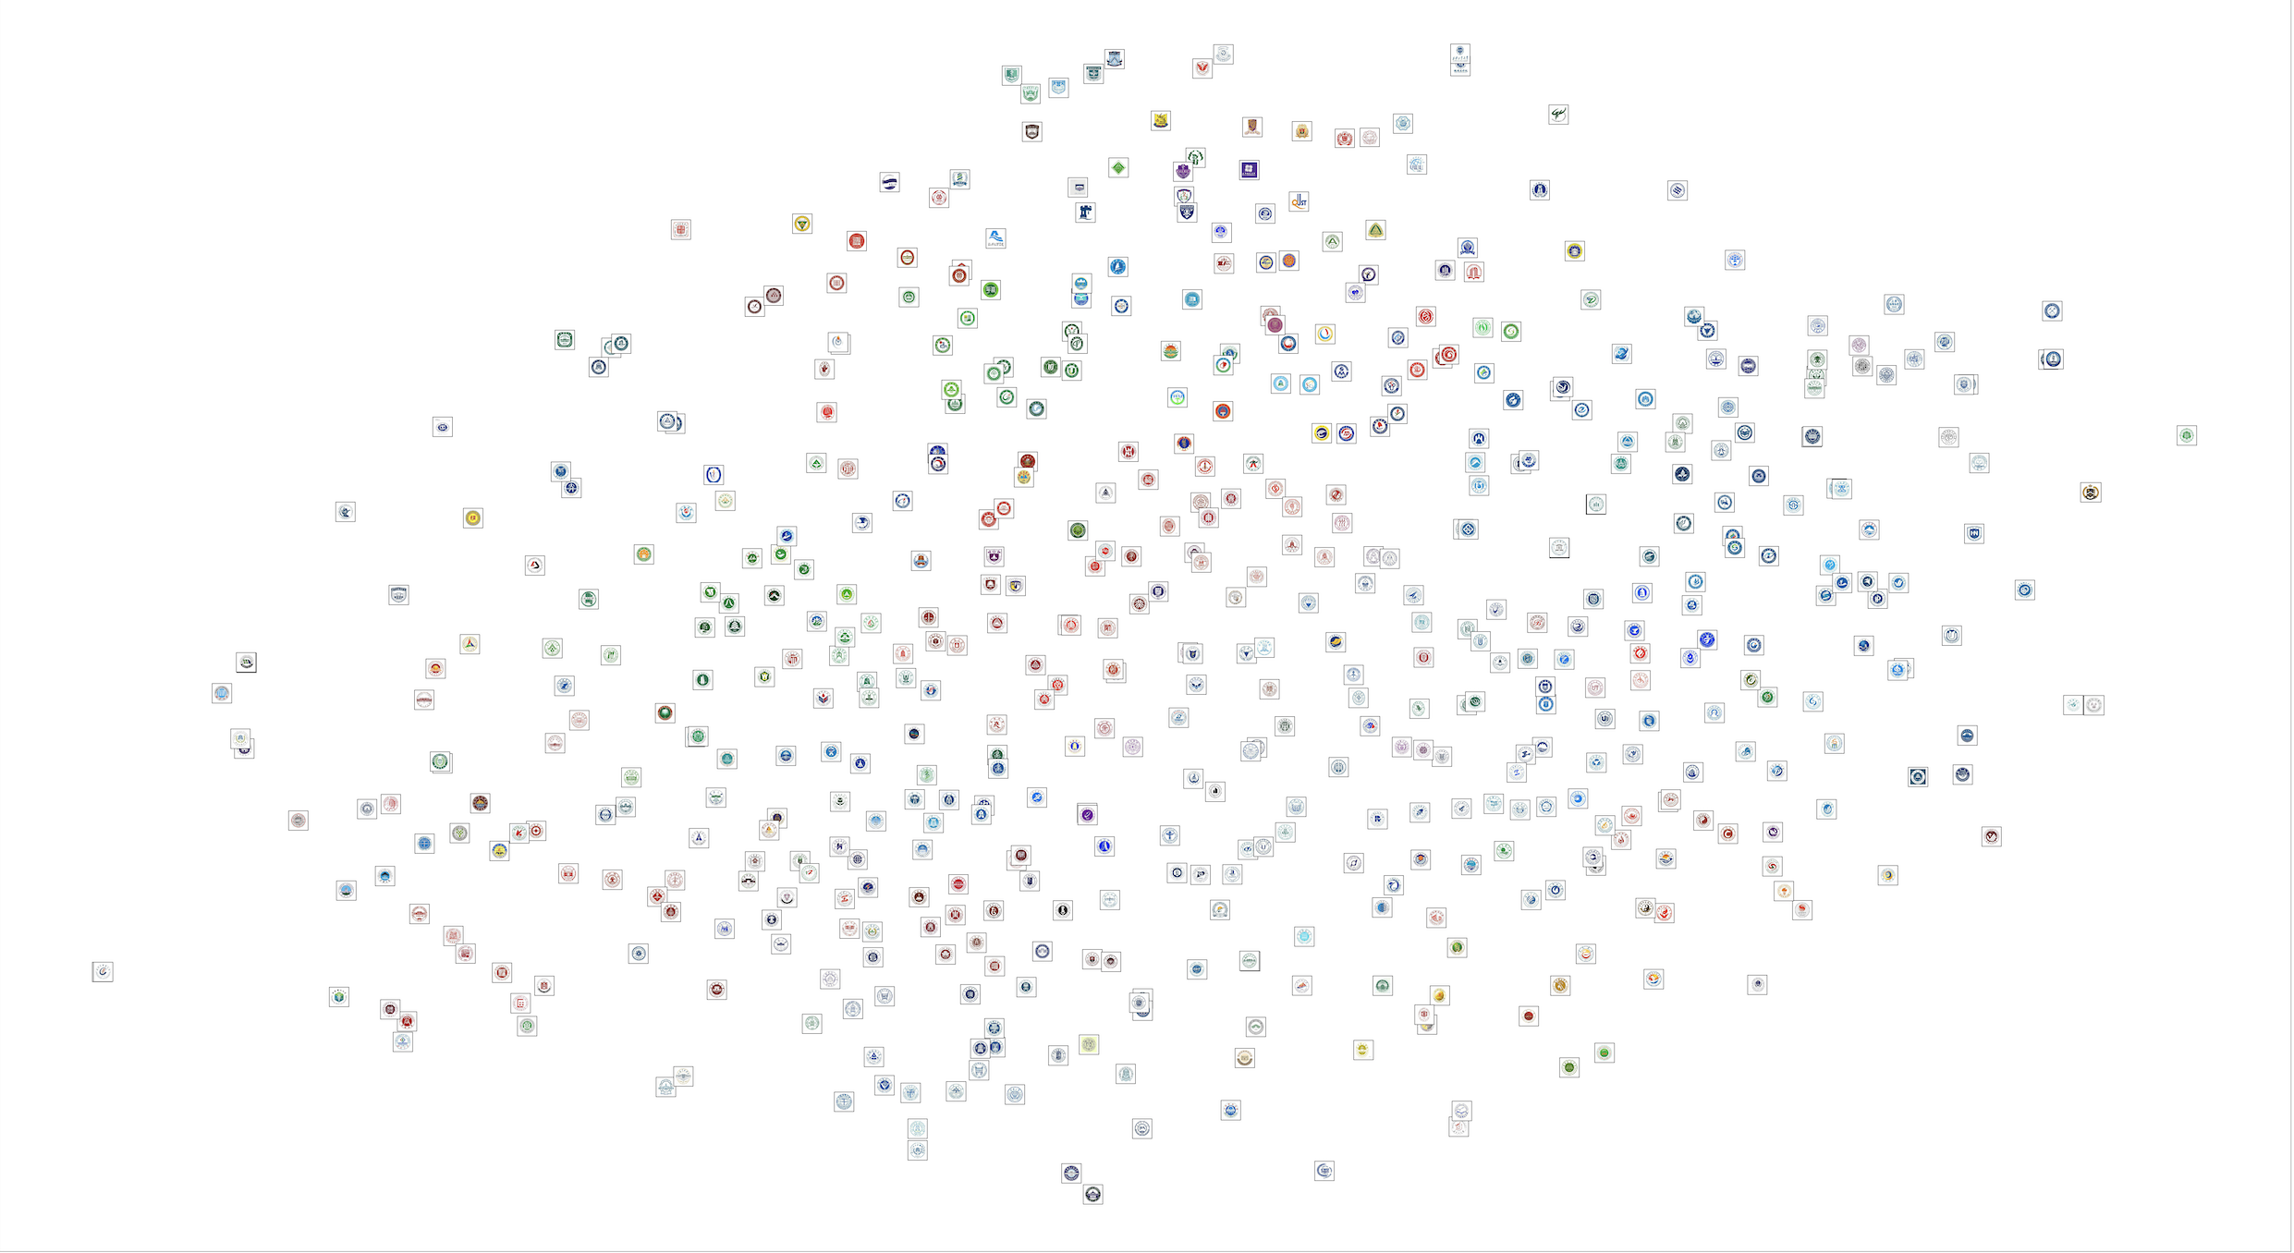












Pca result

Slide 17
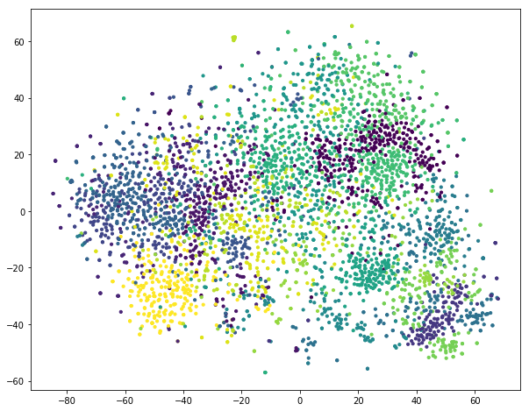
Clustering Result
K-means is applied.
Clustered in 280 dimension and plot in 2 dimension..
Totally 20 clusters.

Slide 18
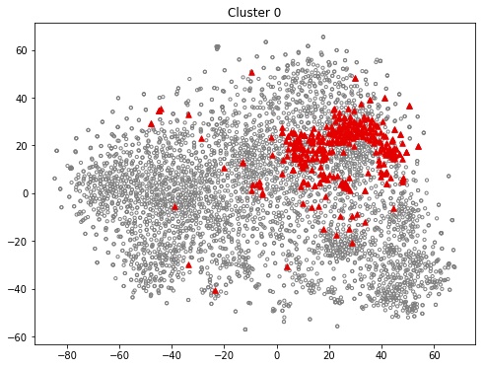
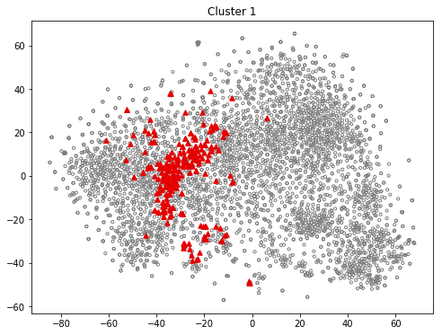
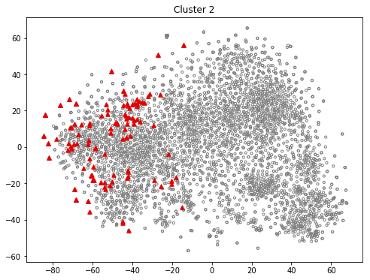
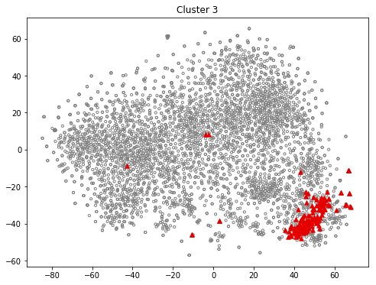
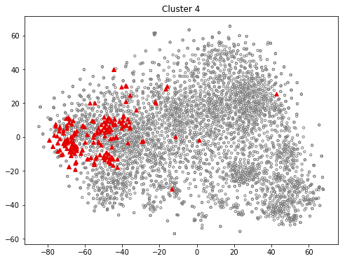
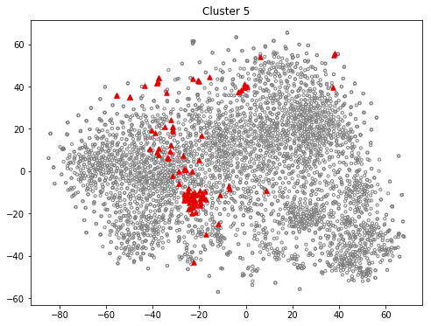
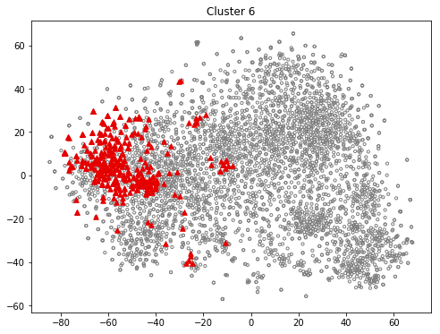
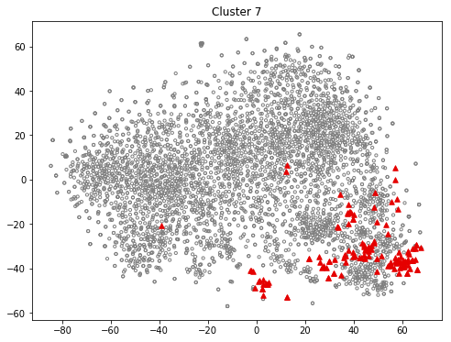
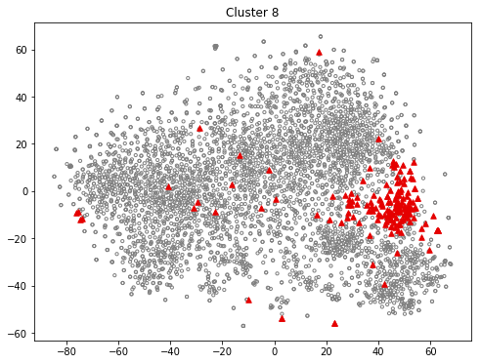
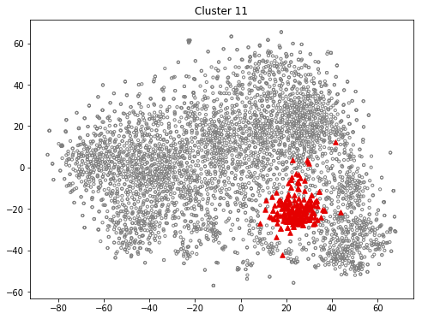
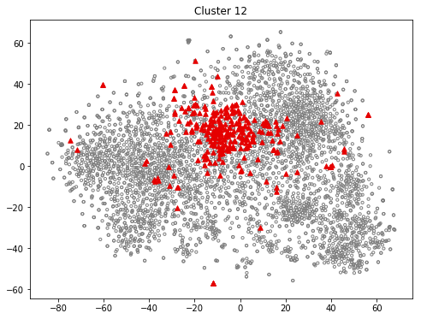
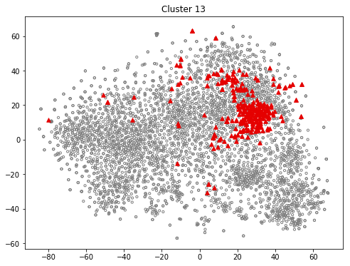
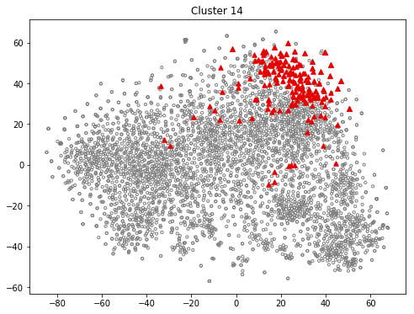
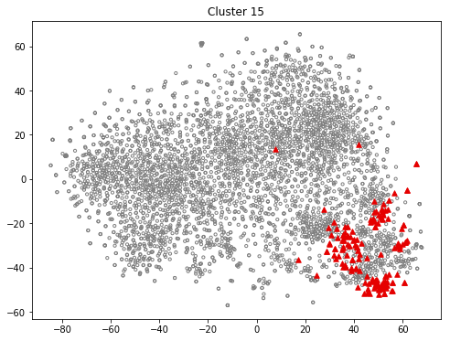
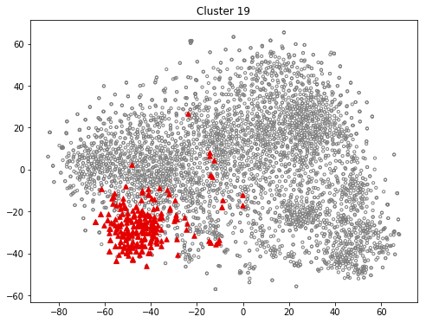
Clustering Result
Totally 20 clusters, well separated.

Slide 19
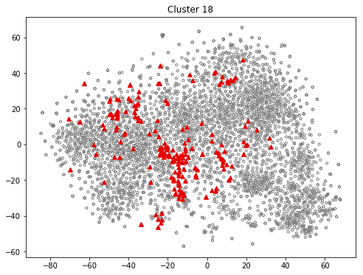

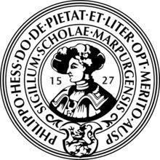
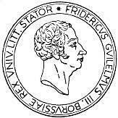




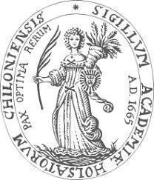
Clustering Result
Expectedly, universities from the same country tend to clustered together. And each country has some popular icons which others countries do not have .
Germany：53%
King, Queen, Goddess

Slide 20







Clustering Result
Expectedly, universities from the same country tend to clustered together. And each country has some popular icons which others countries do not have .
Indian：24%
Rising Sun from sea and ocean.
“The Department of Sanskrit （ 梵语 ）was the first and the. only department in the university.”
Notes:
ganges
The Department of theology， buddhism，Sanskrit （梵语） was the first and the only department in the university

Slide 21
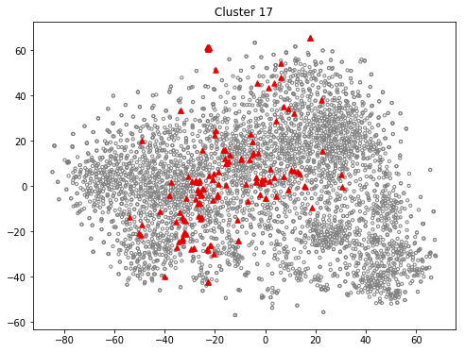








Clustering Result
Expectedly, universities from the same country tend to clustered together. And each country has some popular icons which others countries do not have .
Japan：13%
Just the character: university

Slide 22








Clustering Result
Expectedly, universities from the same country tend to clustered together. And each country has some popular icons which others countries do not have .
USA：89%
Torch and book

Slide 23




Clustering Result
Expectedly, universities from the same country tend to clustered together. And each country has some popular icons which others countries do not have .
USA：89%
Lamp and book

Slide 24





Clustering Result
Expectedly, universities from the same country tend to clustered together. And each country has some popular icons which others countries do not have .
UK：17%
Shield and a hat

Slide 25

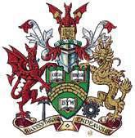

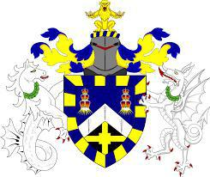


Clustering Result
In some clusters, two countries share a common icon.
UK：15%
Canada：13%
Two animal and one shield.

Slide 26
Clustering Result
Among those clusters, we found 3 cluster most interesting.

Slide 27
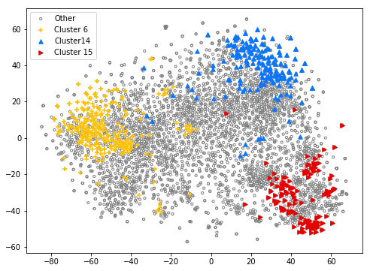
Clustering Result
Among those clusters, we found 3 cluster most interesting.
Have some similar icons. But can be divided into more smaller communities.
Cluster 6 are mainly consists of Chinese Universities.
Cluster 14 are mainly American Universities.
Cluster 15 is almost evenly distributed, but the logos inside are very strange…
We decide to do Community Detection separately within this clusters.

Slide 28
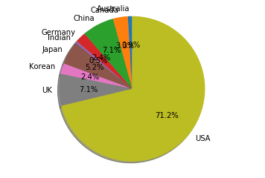
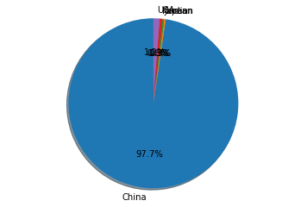
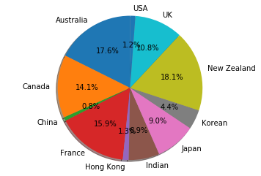
Clustering Result

Slide 29
Community Detection
Within cluster

Slide 30
Distance matrix
Euclidean distance in the autoencoder hidden space
Generate edges
Choose a threshold.
Node deletion
To make graph sparse
Community detection algorithms
Cluster leading eigenvector algorithm
Analysis
Igraph and our 3D visualization demo
workflow

Slide 31
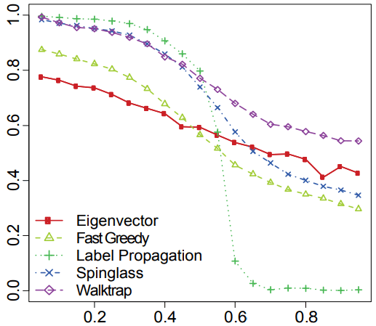
Comparison of CD algorithms
EDGE BETWEENNESS
Fastgreedy
walktrap
Spinglass
Label propagation
Leading eigenvector
Also the leading eigenvector did not give the best result, it did provide the best visualization result. The graph generated by leading eigenvector is more sparse and we can see it more clearly by our eyes.

Slide 32
result anslysis
some interesting results

Slide 33
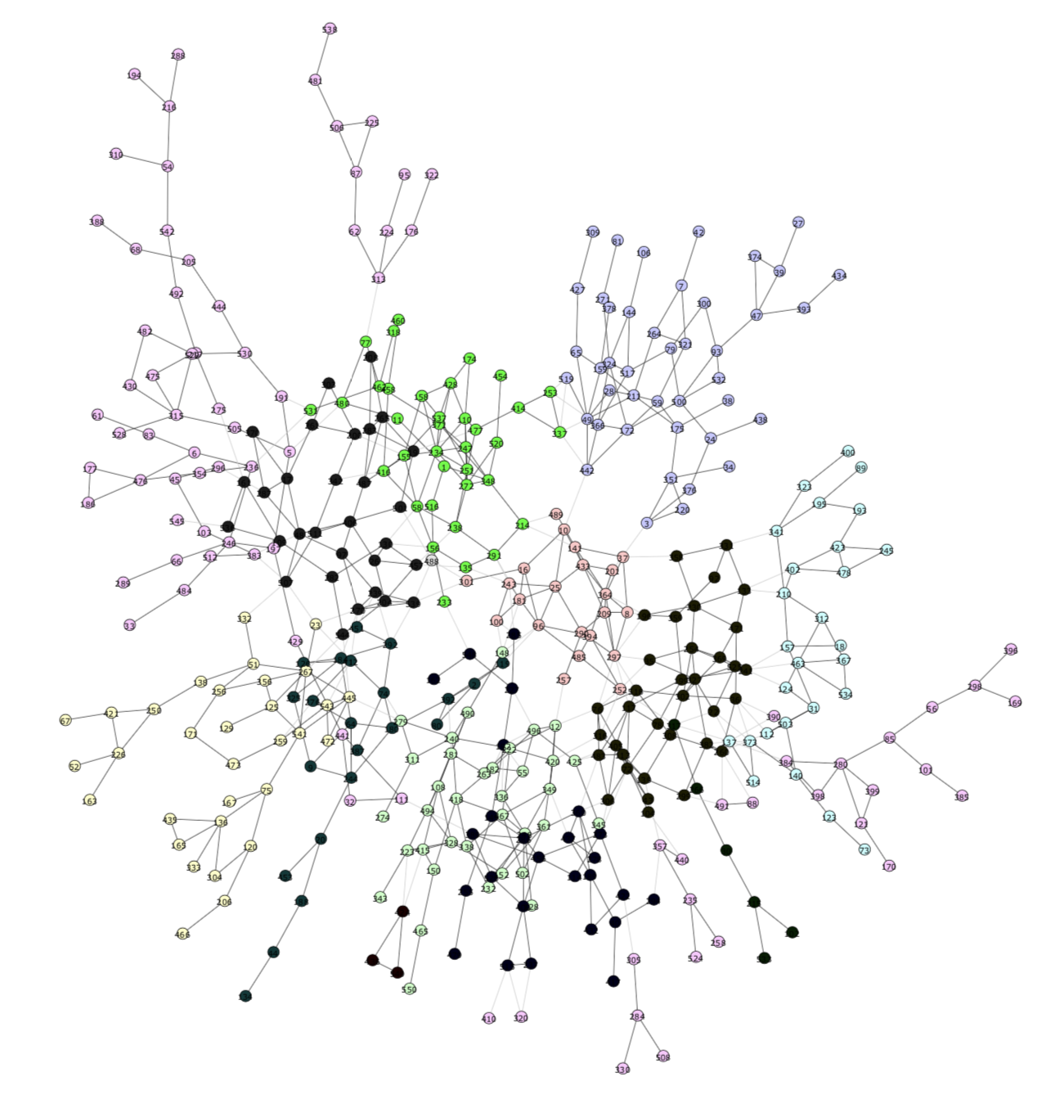






previous finding:cluster 6
Bunch of medical schools
Their badges are …
Rod of Asclepius
/əˈsklipiəs/

Slide 34







Bunch of medical schools
Medical schools but its icon is twisted
Bunch of badges with smooth curves and birds

Slide 35
New findings

Slide 36
Cluster 15
Community detection result
Most interesting group!
Badges which shape is not traditional.
Formed a lot of communities with 2-4 nodes.
We found that within each community, also it has little members, the relationship between each members are quite special.
See our demo in visualization part.

Slide 37
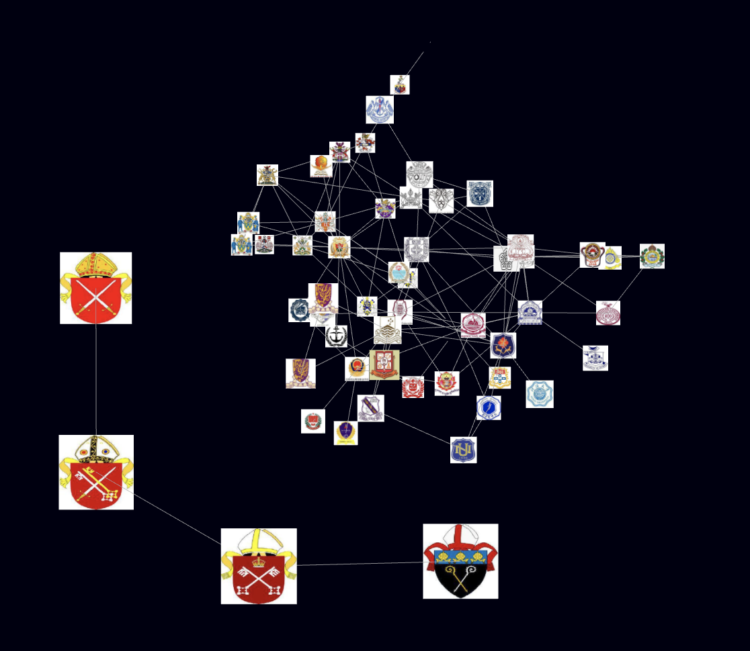
Cluster 15
Community detection result
One group far away from the big network. Remember cluster 15 is far away from other clusters also.
University of Diocese Guildford， University of Diocese of Bradford， University of Diocese of Canterbury， University of Diocese of Rochester.

Slide 38
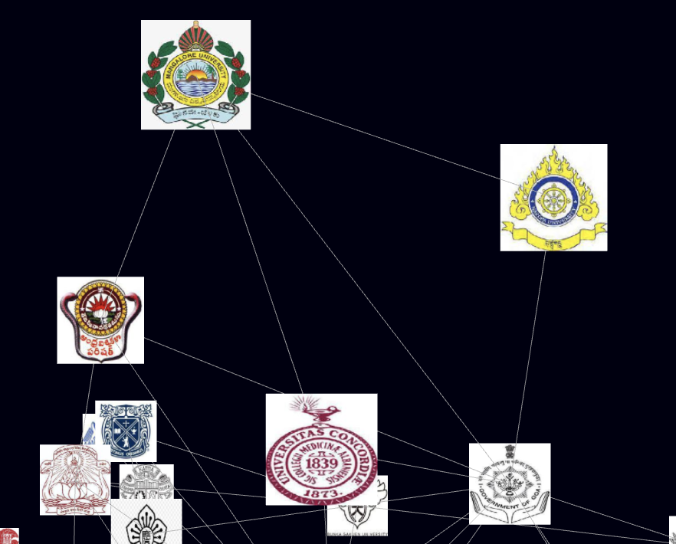
Cluster 15
Community detection result
One USA school in the group of Indian schools.
Naropa University
Naropa University is a private liberal arts university in Boulder, Colorado. Founded in 1974 by Tibetan Buddhist teacher Chögyam Trungpa, it is named for the 11th-century Indian Buddhist sage Naropa, an abbot of Nalanda. The university describes itself as Buddhist-inspired, ecumenical, and nonsectarian rather than Buddhist.

Slide 39
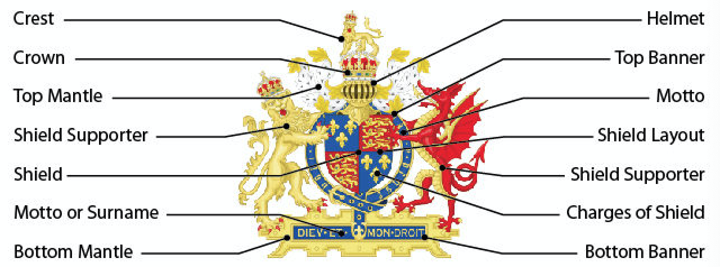



Coat of arms (纹章)
Mostly universities in the European.
Coat of arms from the night in middle ages
Notes:
盾徽是在12世纪，由封建领主和骑士在战场上开始广泛使用的。从13世纪开始，这种盾徽开始不局限于在战场上使用，而是成为一种欧洲上层社会家族所使用的旗帜或标志，一代传一代。尤其是那些有权使用盾徽的人，在法律或社会习惯上，开始逐渐演变为国家权力。在德语区，贵族和平民都会使用盾徽，而在欧洲其他地区，仅有贵族才能使用盾徽。之后教堂的神职人员也开始使用盾徽，接着是小镇用于镇民识别，以及像是大学及商贸公司这类皇家特许的机构。旗帜是由盾徽发展而来的，旗帜学和纹章学的艺术是非常相近的。盾徽是商业公司现代标志的主要资源。
在21世纪，大量机构及个人仍旧在使用盾徽；比如很多欧洲城市和大学都有关于如何使用盾徽的指引，并且将其作为商标保护。很多社团也帮助设计并注册个人盾徽。在某些国家，比如英格兰和苏格兰，持续数个世纪仍旧保持与当时所授予的盾徽相同的纹章格局并持续管理至今。
Some of the universities badges are just coat of arms
It is actually from the night in the Middle ages, there all rage with armour and helment . So that nobody can see them. And the cost of arms are using for their identification.
Consist of……
oak tree taken from the coat of arms of the former Hatfield Rural District,
The stars recalling the emblem of the former Hatfield University.
The crest, a Phoenix rising from an astral crown, represents the University's evolution from a technical collegetraining apprentices for the aviation industry.
The two harts supporting the shield represent the county of Hertfordshire

Slide 40
Religion & badges
Christianism in USA:
Christianism in UK:
Buddhism in India:

Slide 41
Findings
Religion & badges
Why is that?
The University Evolution:
Church → Abbey → University
Many universities are founded by church and their were pursuing theology at first time.
“从教会—修道院—大学的历史演变中， 我们可以看出， 任何时代和社会都需要一个承担反映社 会进步与广大人民精神追求的组织或机构。 在中世纪， 当正教合一的基督教会无力维持绝对权威时， 经由修道院中介， 承担社会终极价值意义阐释与教化的功能便历史性地传递给了大学， 大学成为代表社会发展方向的、 新的精神空间。”
--- 林琳， 刘亚敏. 基督教信仰与大学起源 [J] . 高教研究， 2006， (6).

Slide 42
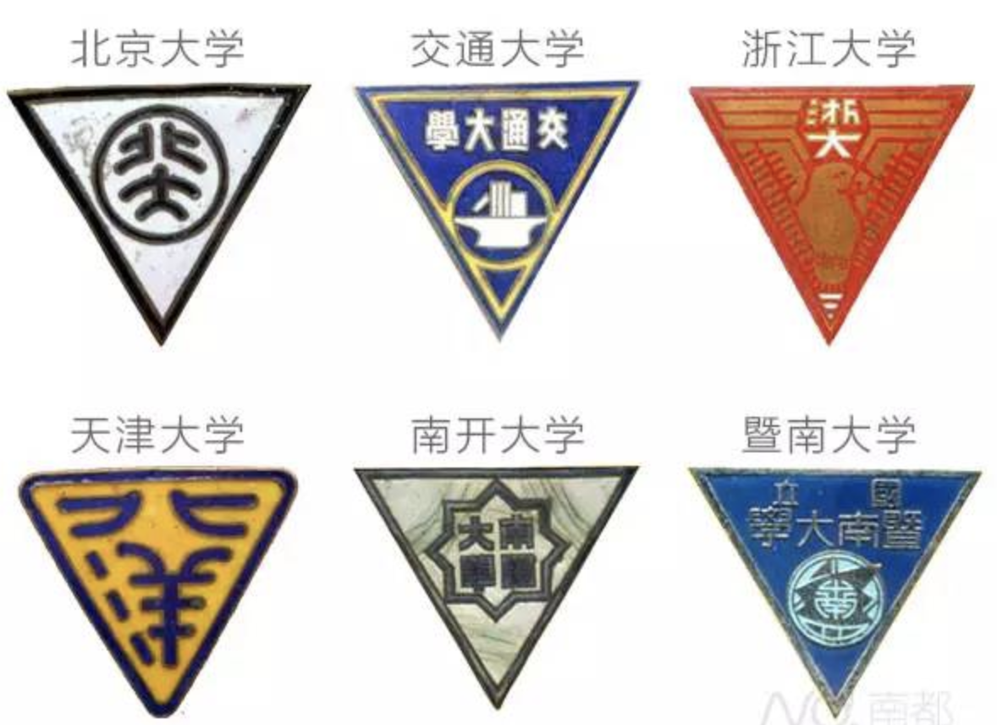
Compared with china
The goal of earliest universities in China is learning advanced technology and thoughts from the western world.

Slide 43
Summary
Autoencoder to extract features
K-means clustering
Community detection
Unique pattern within countries.
Religion related image.
Interesting finding in GROUP 15

Slide 44
Something we still want to do

Slide 45
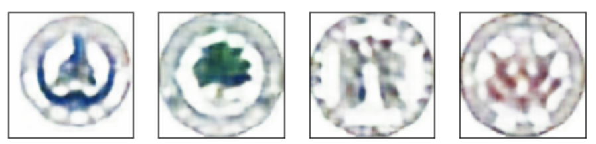
Next step
Since it is quit expense to design new logos for newly founded universities or even companies, we want to using a GAN neural network to generate logo automatically.
We have tried to use our decoder neural network combined with a discriminator to generate some logos from a Gaussian distribution. Which are shown below.
We also would like to apply neural networks that detects a specific icon, such as torch, fire, book, tree, buildings… Then we could analysis the combination of icons appears in the university badges.

Slide 46

Q&A

